Slide 1

IDS 576-Final Project
Real-time Unsupervised Anomaly Detection

Slide 2
Table of Contents
01
02
03
04
Problem Setting
Data Description
Nature of the Problem Statement
Data Extraction, Framework Introduction
Techniques
Results
Models & Technologies Utilized
Performance and Evaluation Measures

Slide 3
01
PROBLEM SETTING

Slide 4
PROBLEM SETTING
Identifying irregularities in images is a more challenging task compared to detecting anomalies in structured data. However, utilizing Deep Learning (DL) techniques can provide a solution as these models can automatically extract features from unstructured data such as images.
To facilitate the task of doing image anomaly detection, Intel OpenVino has introduced Anomalib, which is a DL framework that provides state-of-the-art anomaly detection algorithms for benchmarking on both public and private datasets.
“Anomalib” will be applied to our project to find images with some defections on the product surface.
GOAL: Utilize Anomalib from Intel OpenVinoToolkit to benchmark, develop, and deploy deep learning-based image anomaly detection.

Slide 5
02
DATA DESCRIPTION

Slide 6
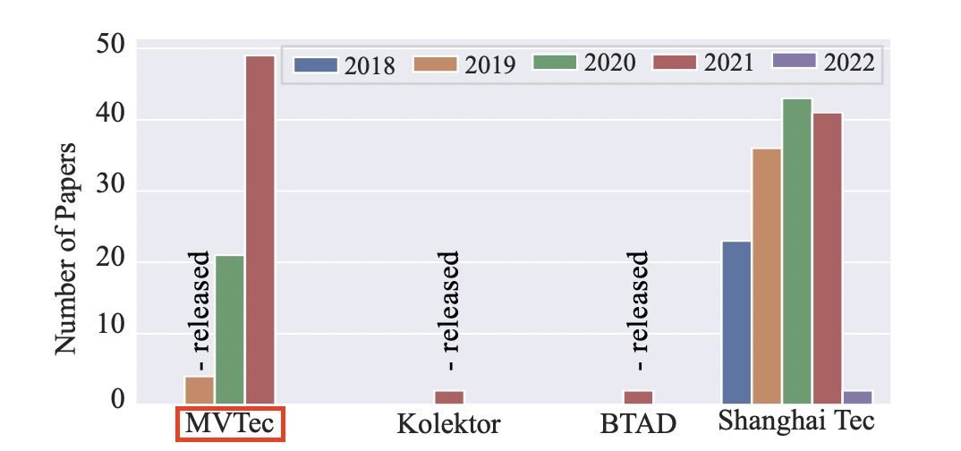
Why we choose MVTec Dataset?
Number of anomaly detection datasets and papers recently released and published in the literature.

Slide 7
DATA DESCRIPTION
A German company MVTec Software GmbH recently released a novel MVTec Anomaly Detection dataset, it has realistic data from 15 categories.
The MVTec Anomaly Detection dataset consists of 15 categories comprising 3,629 images for training and validation, as well as 1,725 images for testing.
The training set exclusively contains images without any defects, while the test set contains both defect-free images and images containing various types of defects.
All images were acquired using a 2048 × 2048 pixel high-resolution industrial RGB sensor in combination with two bilateral telecentric lenses with magnification factors, respectively.

Slide 8
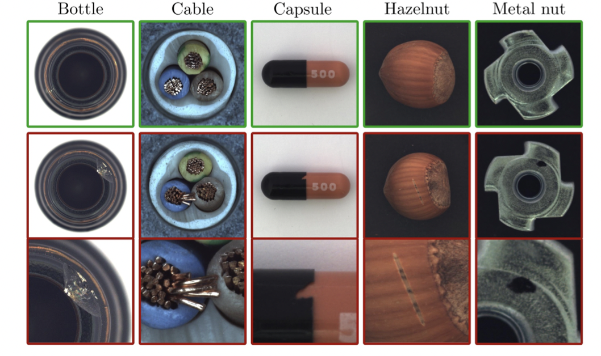
DATA VISUALIZATION
Figure 1: Example images for all five textures and ten object categories of the MVTec AD dataset.

Slide 9

Anomalib is a deep learning library that aims to collect state-of-the-art anomaly detection algorithms for benchmarking on both public and private datasets.
Anomalib provides several ready-to-use implementations of anomaly detection algorithms described in the recent literature, as well as a set of tools that facilitate the development and implementation of custom models.
The library has a strong focus on image-based anomaly detection, where the goal of the algorithm is to identify anomalous images, or anomalous pixel regions within images in a dataset.
Anomalib is constantly updated with new algorithms and training/inference extensions, so keep checking!

Slide 10
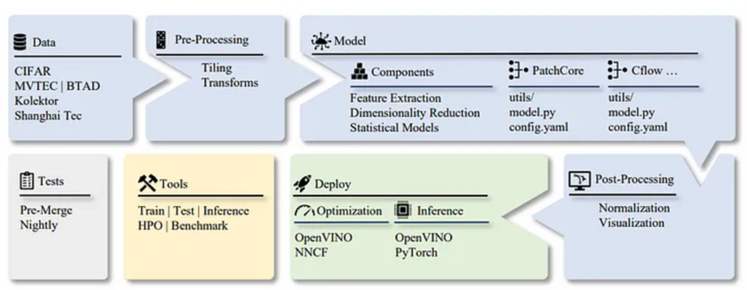
Architecture of the Anomalib library from data to deployment.

Slide 11
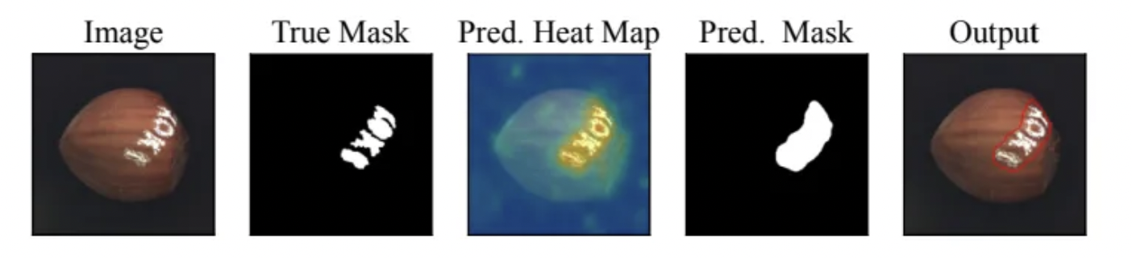
Why Anomalib?
It is hard to capture and annotate a large quantity of anomalous image data. This is why unsupervised anomaly detection is a need of the hour.
Traditional computer vision algorithms are not effective as the difference between normal samples and abnormal samples can be very small. Yet there can be numerous types of variations and hence hard to anticipate all types of image anomalies beforehand. So, DL based approaches can automatically learn the difference between normal and abnormal features.
You can use Anomalib for detection and localization at a global as well as a local scale. So, you can not only identify different types of anomalies but also highlight local pixel-level anomalous region.
An exemplary output produced by the anomalib visualization tools.

Slide 12
03
Techniques
STFPM & Reverse Distillation

Slide 13
STFPM
STFPM algorithm consists of a pre-trained teacher network and a student network with identical architecture.
The student network learns the distribution of anomaly-free images by matching the features with the counterpart features in the teacher network.
Multi-scale feature matching is used to enhance robustness.
This hierarchical feature matching enables the student network to receive a mixture of multi-level knowledge from the feature pyramid thus allowing for anomaly detection of various sizes.
During inference, the feature pyramids of teacher and student networks are compared. Larger difference indicates a higher probability of anomaly occurrence.

Slide 14
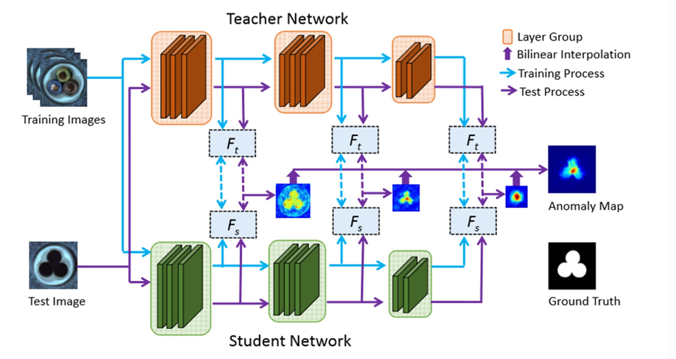
STFPM
Student-Teacher Feature Pyramid Matching for Unsupervised Anomaly Detection

Slide 15
Reverse Distillation
Reverse Distillation model consists of three networks.
The first is a pre-trained feature extractor (E). The next two are the one-class bottleneck embedding (OCBE) and the student decoder network (D).
The backbone E is a ResNet model pre-trained on ImageNet dataset. During the forward pass, features from three ResNet block are extracted.
These features are encoded by concatenating the three feature maps using the multi-scale feature fusion block of OCBE and passed to the decoder D.
The decoder network is symmetrical to the feature extractor but reversed.
During training, outputs from these symmetrical blocks are forced to be similar to the corresponding feature extractor layers by using cosine distance as the loss metric.

Slide 16
Reverse Distillation
During testing, a similar step is followed but this time the cosine distance between the feature maps is used to indicate the presence of anomalies.
The distance maps from all the three layers are up-sampled to the image size and added (or multiplied) to produce the final feature map.
Gaussian blur is applied to the output map to make it smoother. Finally, the anomaly map is generated by applying min-max normalization on the output map

Slide 17
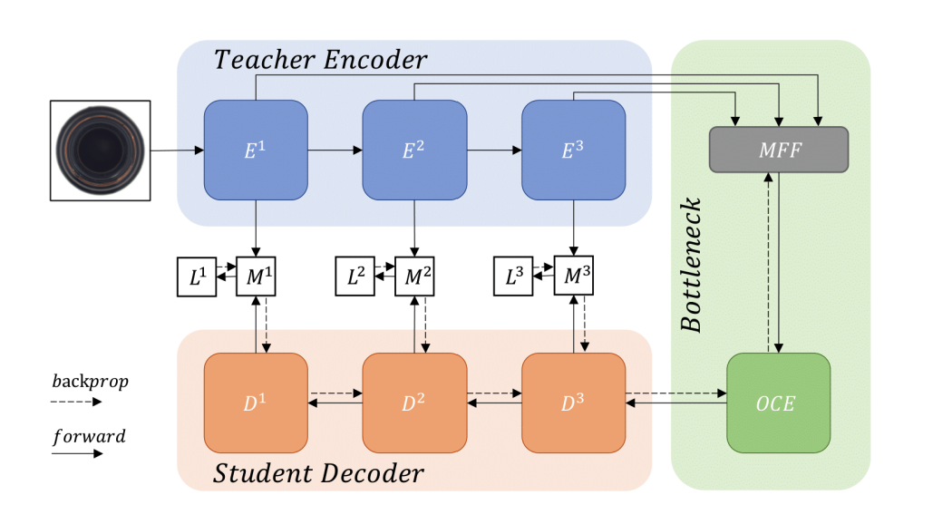
Reverse Distillation
Anomaly Detection via Reverse Distillation from One-Class Embedding

Slide 18
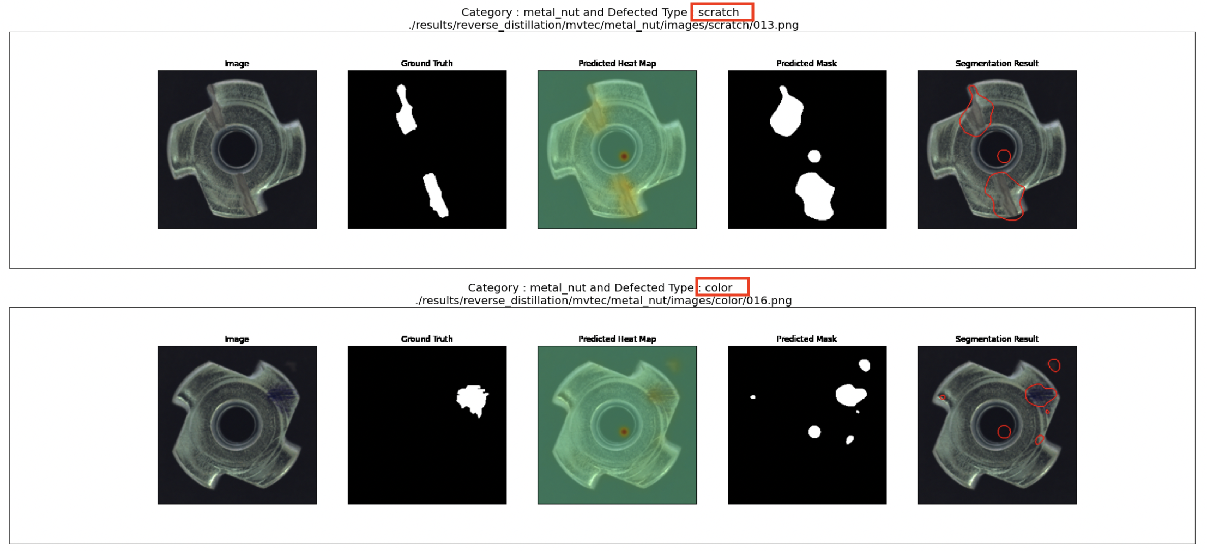
Reverse Distillation

Slide 19
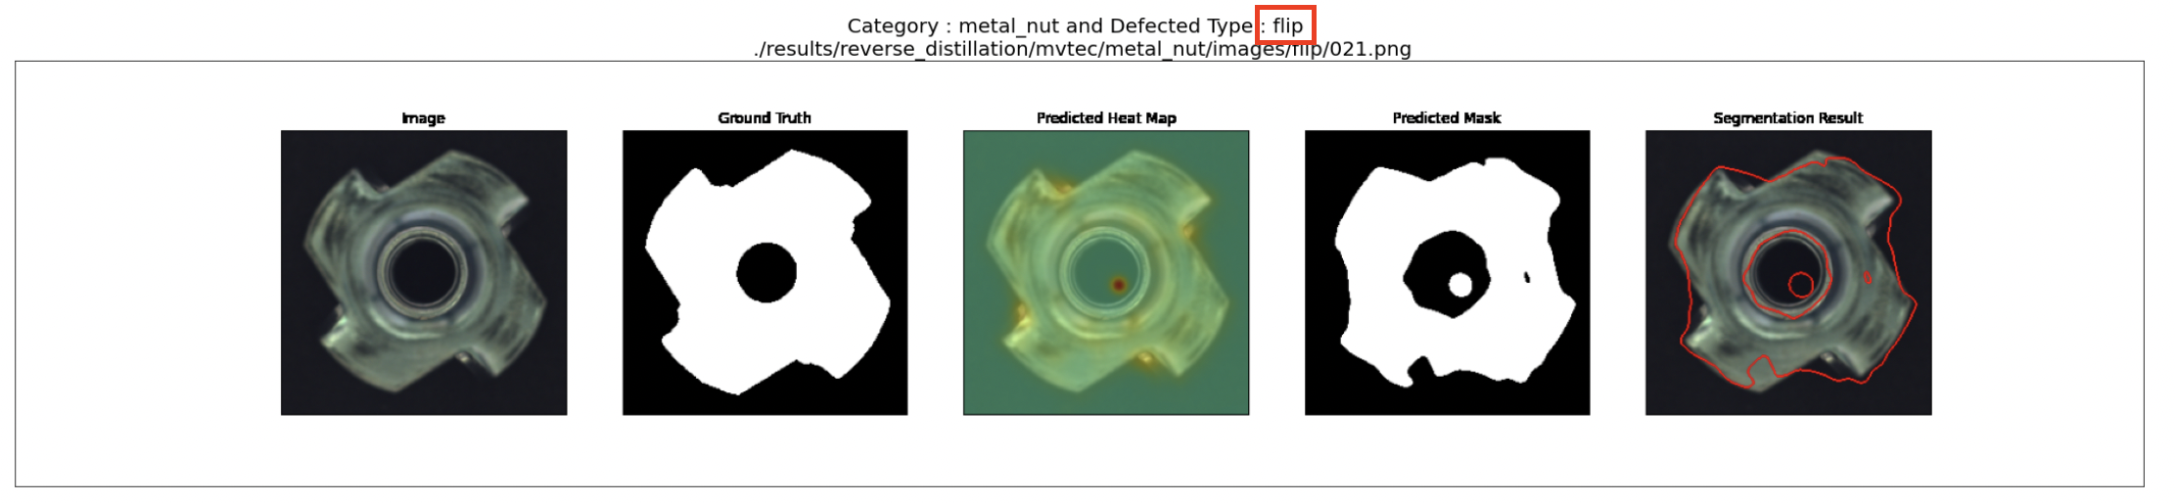
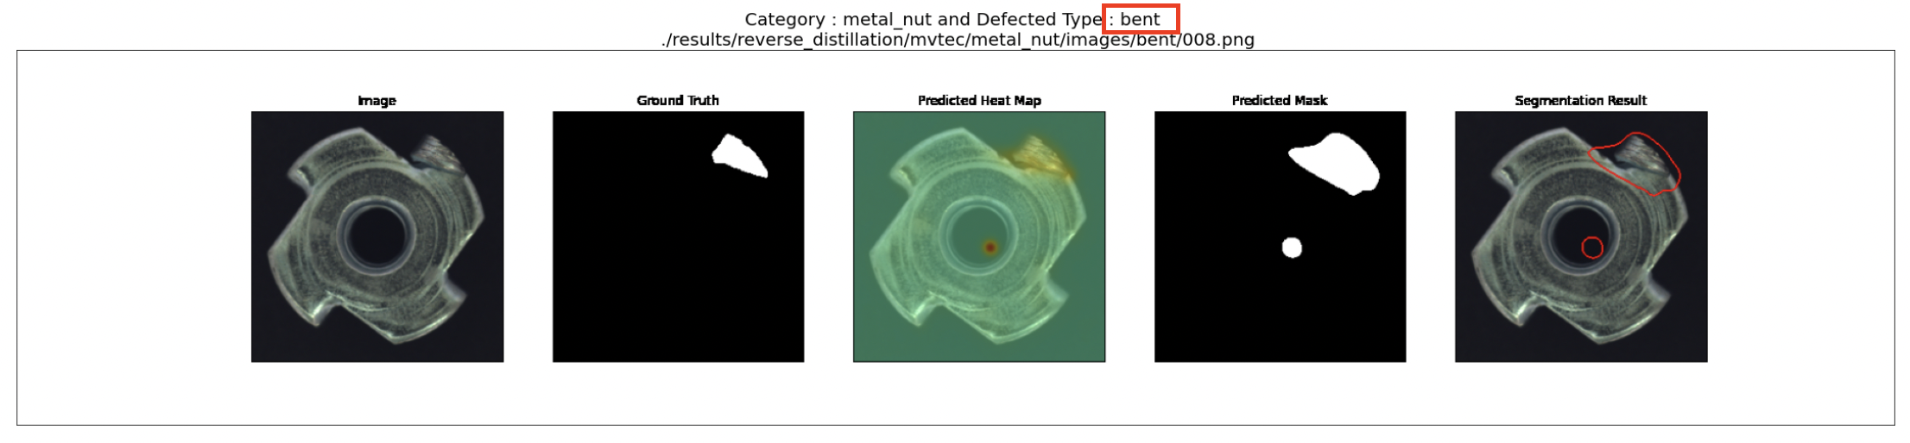
Reverse Distillation

Slide 20
04
Result
Prediction...

Slide 21
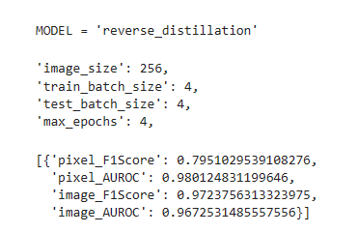
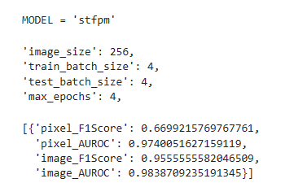
Unsupervised Models and Evaluation
Notes:
Conclusion: We introduce the MVTec Anomaly Detection dataset, a novel dataset for unsupervised anomaly detection mimicking real-world industrial inspection scenarios. The dataset provides the possibility to evaluate unsupervised anomaly detection methods on various texture and object classes with different types of anomalies. Because pixel-precise ground truth labels for anomalous regions in the images are pro- vided, it is possible to evaluate anomaly detection methods for both image-level classification as well as pixel-level seg- mentation.
Several state-of-the-art methods as well as two classical methods were thoroughly evaluated on this dataset. The evaluations provide a first benchmark on this dataset and show that there is still considerable room for improvement.
It is our hope that the proposed dataset will stimulate the development of new unsupervised anomaly detection methods.

Slide 22

THANK YOU !!!

